Slide 1
Pell City High School Scholarship Acclamation 2017

Slide 2
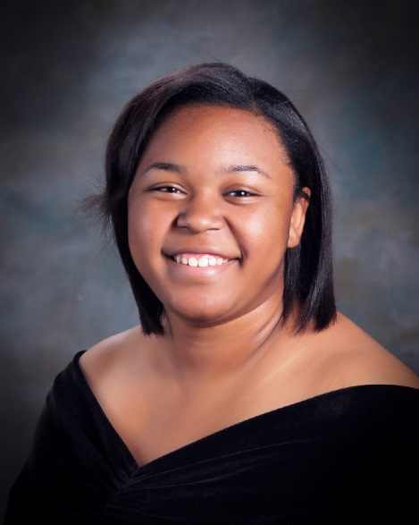
Mia Allen
Scholarships

Slide 3
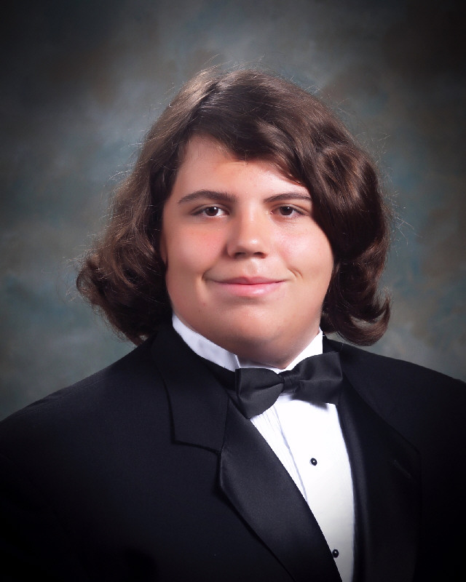
Adrian Bates
Scholarships

Slide 4
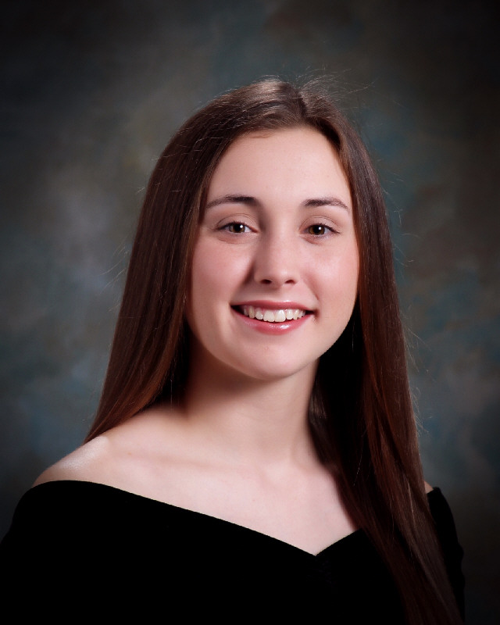
Maggie Bowling
Scholarships

Slide 5
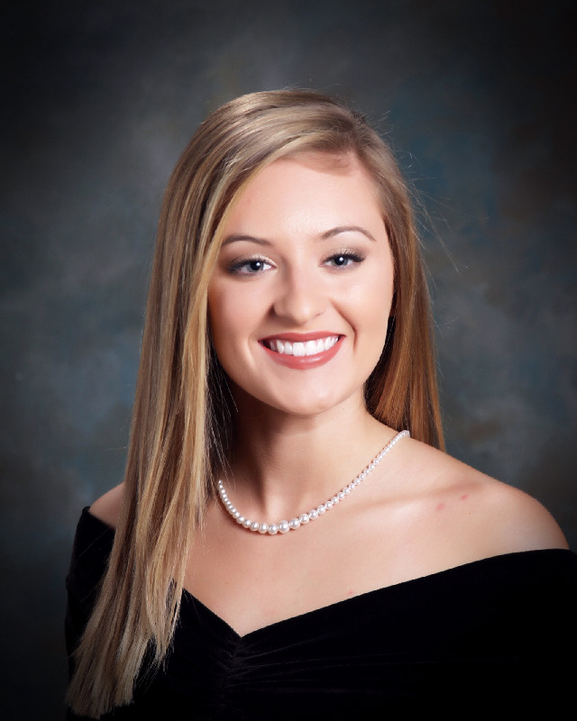
Madison Bowman
Scholarships

Slide 6
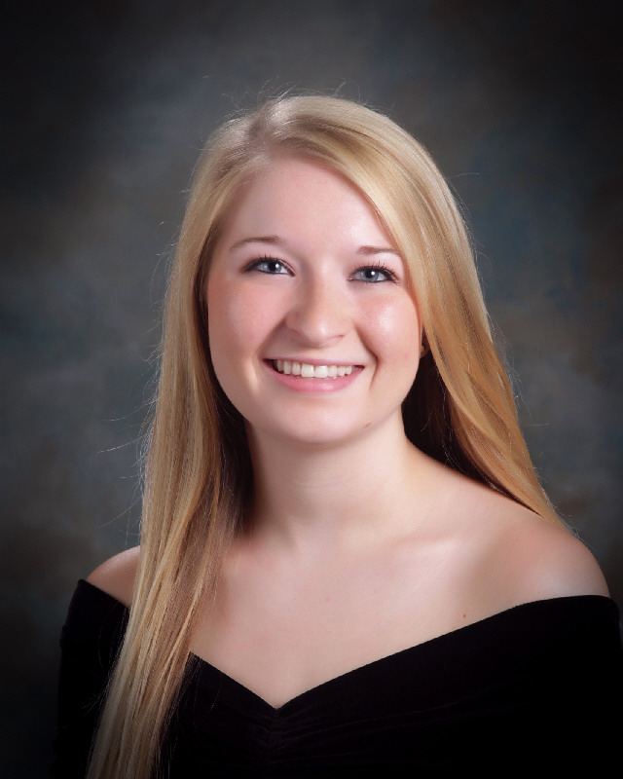
Taylen Bowman
Scholarships

Slide 7
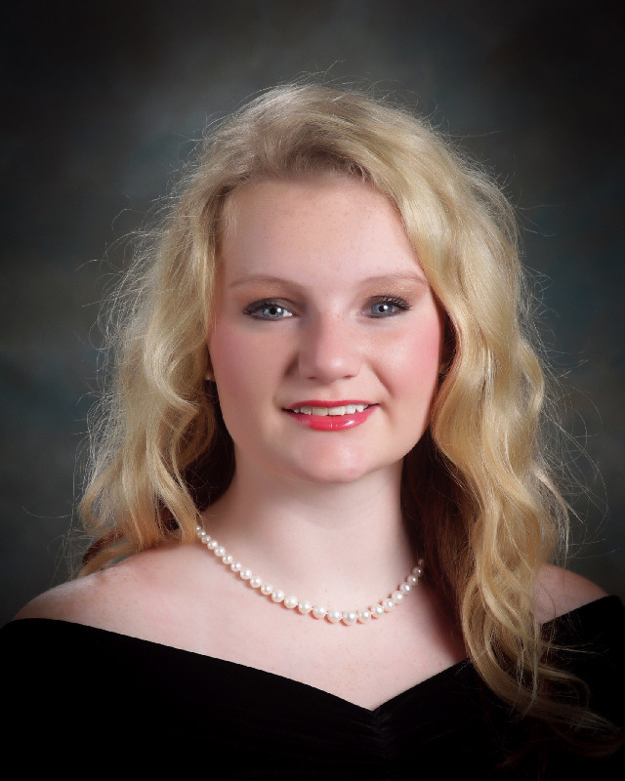
Danya Brown
Scholarships

Slide 8
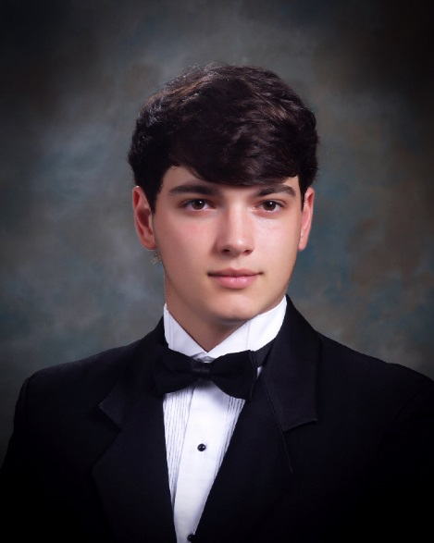
Jeffrey Bullard
Scholarships

Slide 9
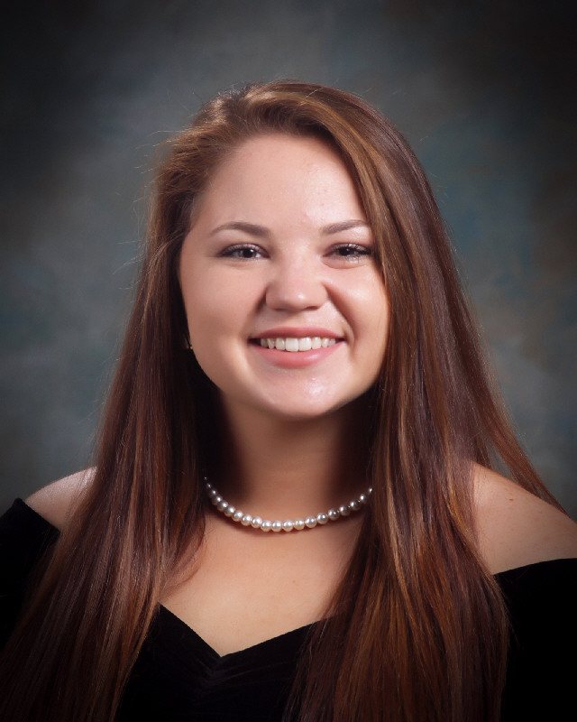
Elizabeth Burns
Scholarships

Slide 10
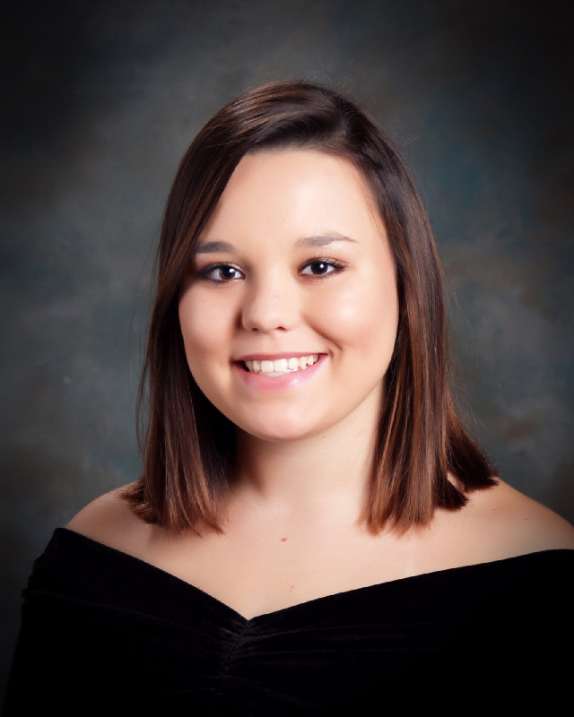
Sierra Canary
Scholarships

Slide 11
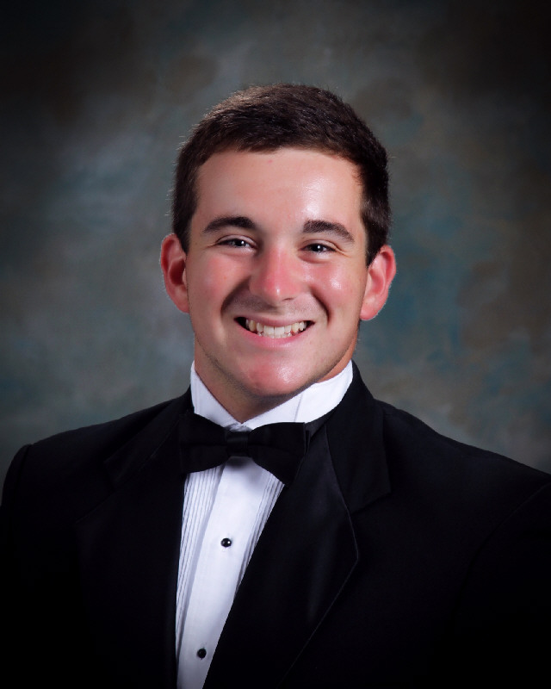
Austin Carleton
Scholarships

Slide 12
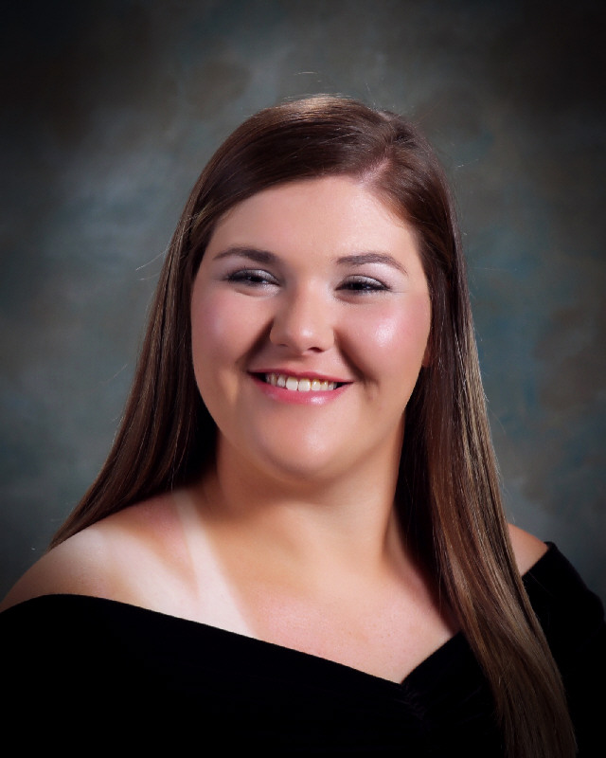
Cayla Carpenter
Scholarships

Slide 13
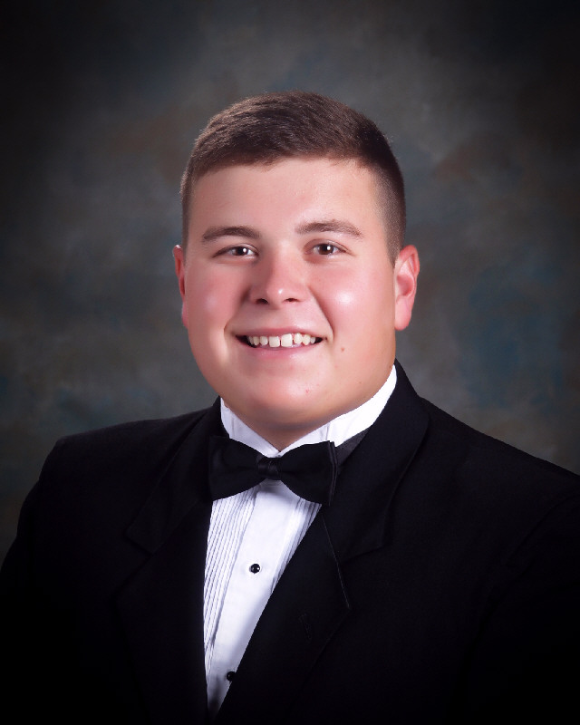
Ben Castleberry
Scholarships

Slide 14
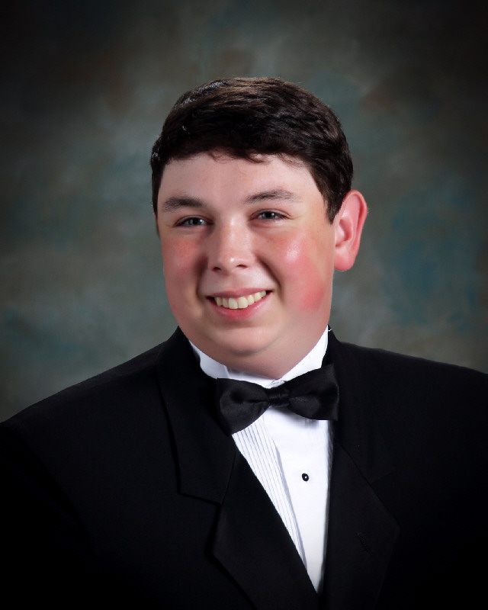
Peyton Cofer
Scholarships

Slide 15
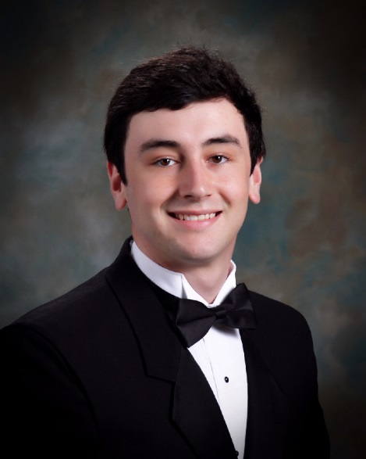
Nigel Collier
Scholarships

Slide 16
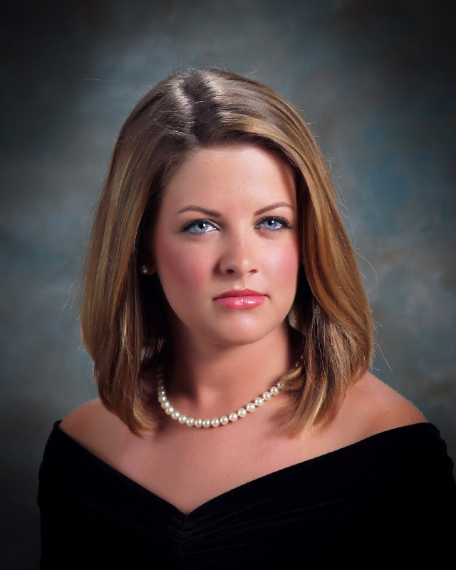
Caroline Costello
Scholarships

Slide 17
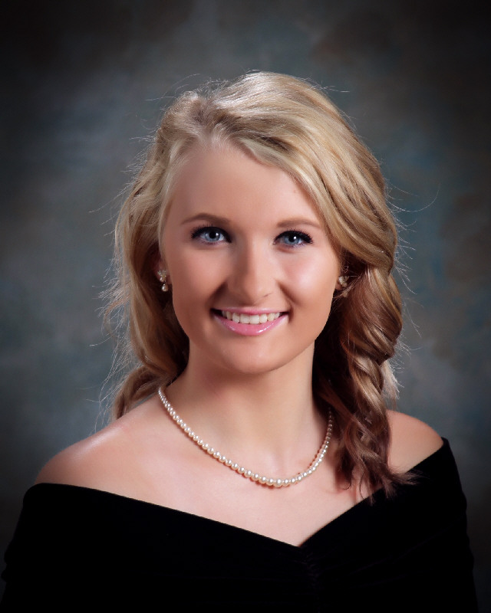
Emily Danzey
Scholarships

Slide 18
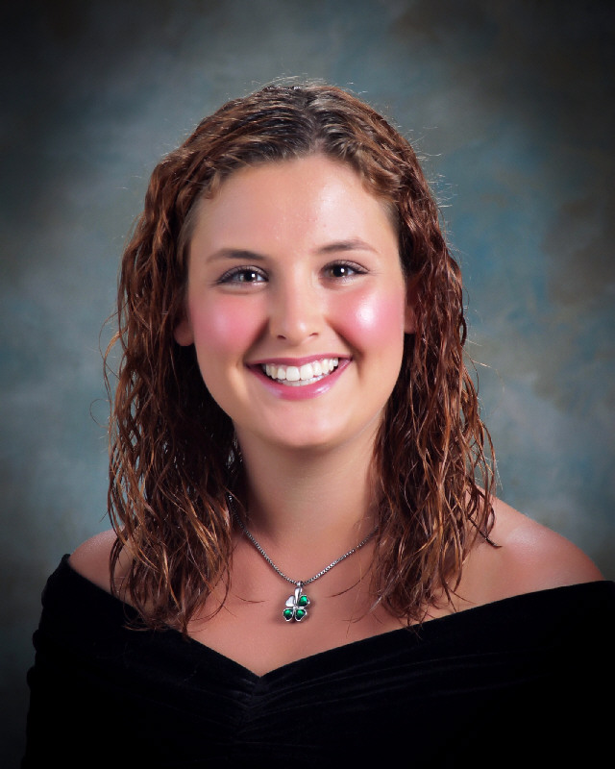
Caitlynn Darby
Scholarships

Slide 19
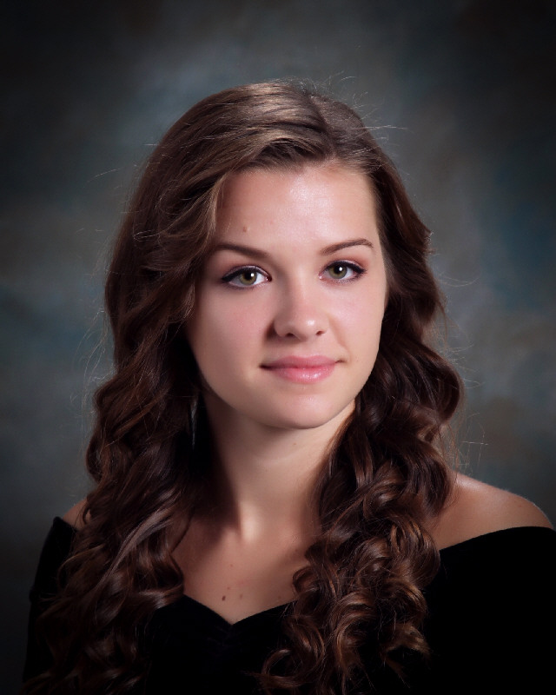
Olivia Dewberry
Scholarships

Slide 20
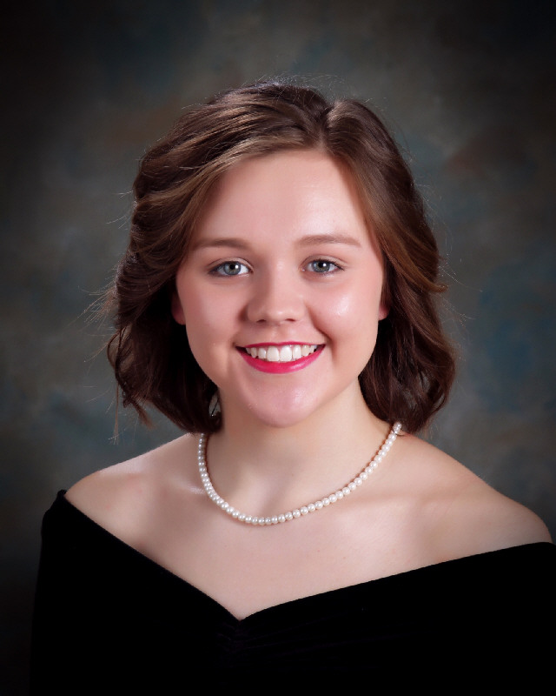
Allison Epperson
Scholarships

Slide 21
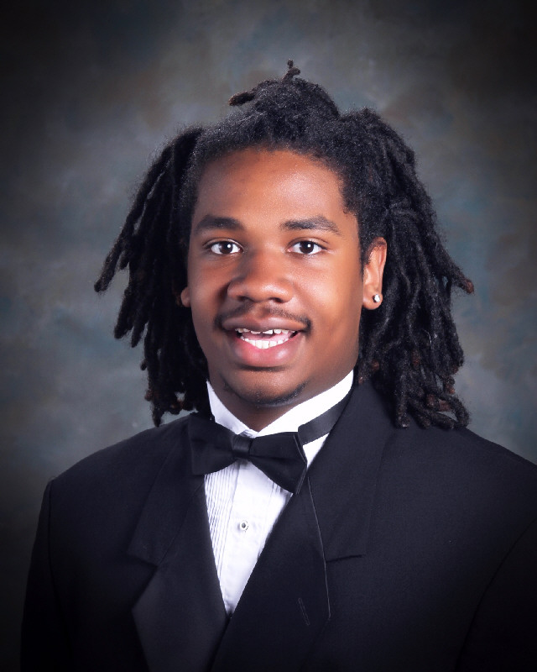
Jarrell Estell
Scholarships

Slide 22
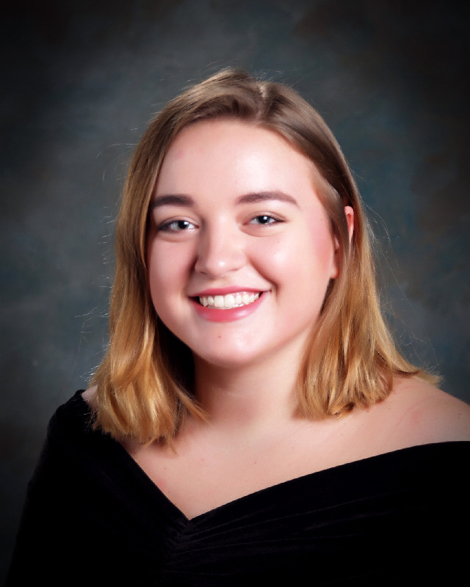
Ellie Funderburg
Scholarships

Slide 23
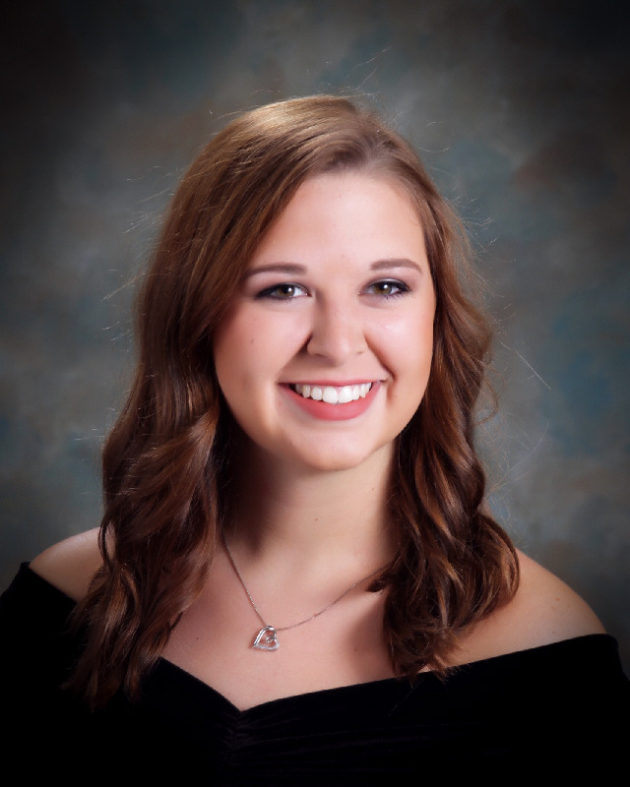
Sydney Gillilan
Scholarships

Slide 24
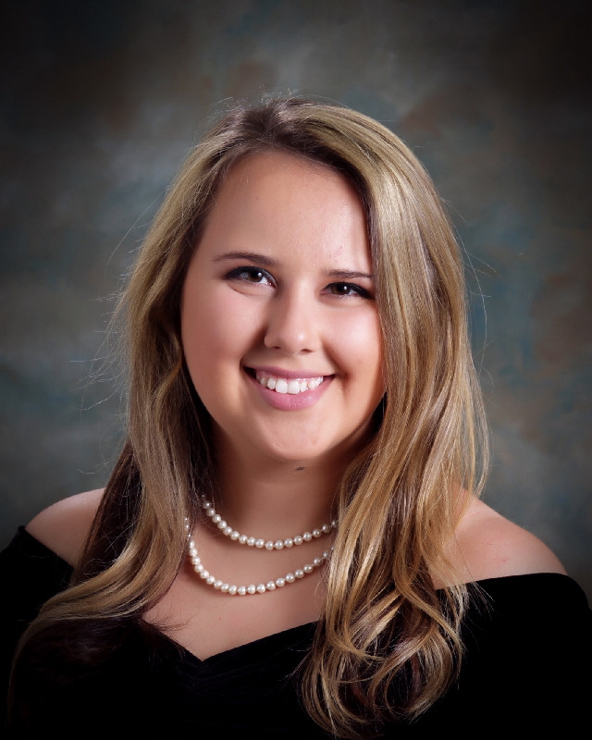
Lauryn Graff
Scholarships

Slide 25
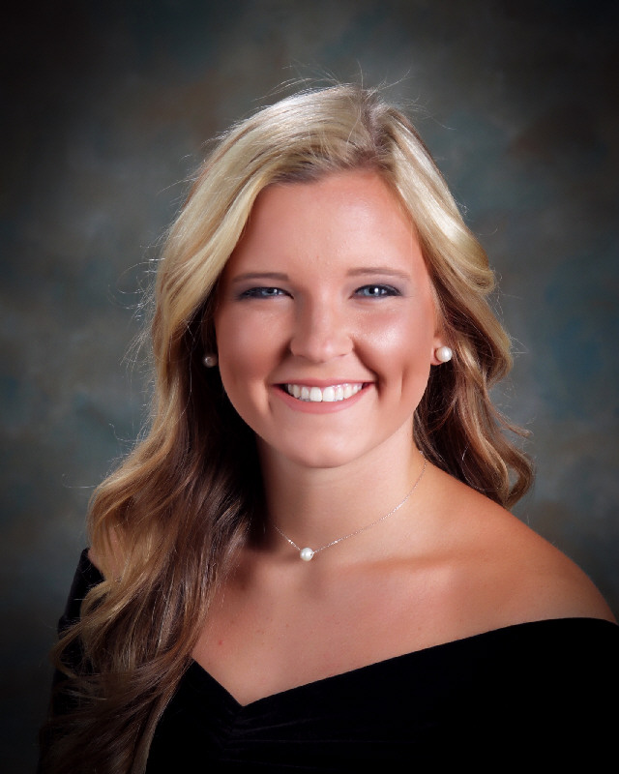
Hilary Hadley
Scholarships

Slide 26
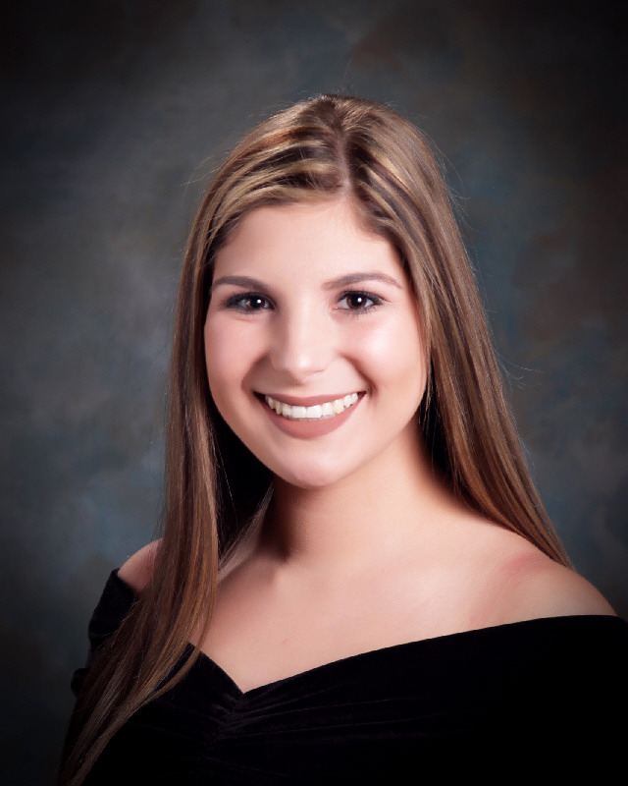
Regan Harmon
Scholarships

Slide 27
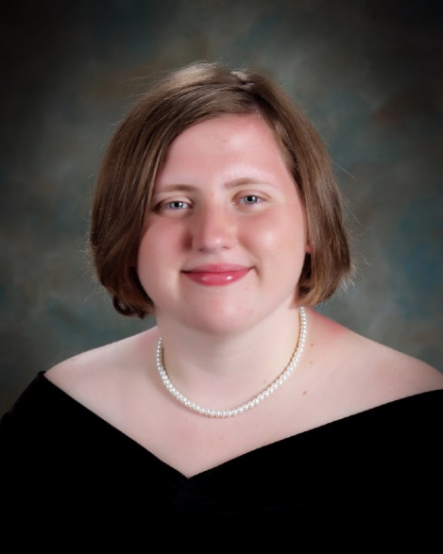
Felicity Harvard
Scholarships

Slide 28
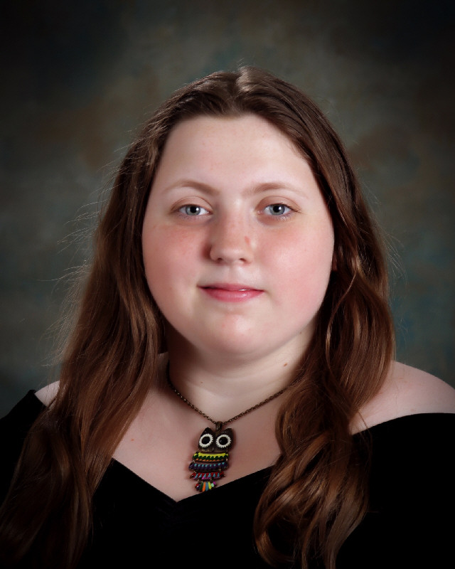
Patience Harvard
Scholarships

Slide 29
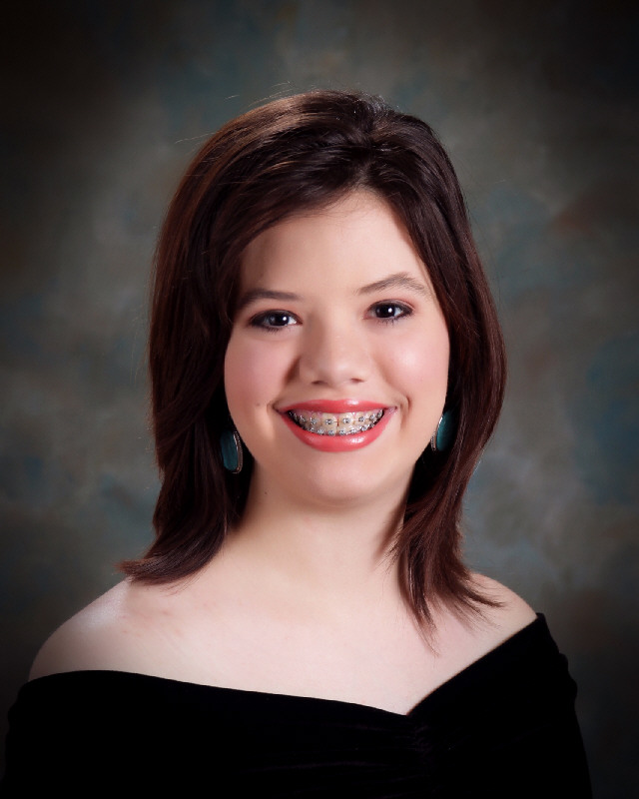
Ashley Himmler
Scholarships

Slide 30
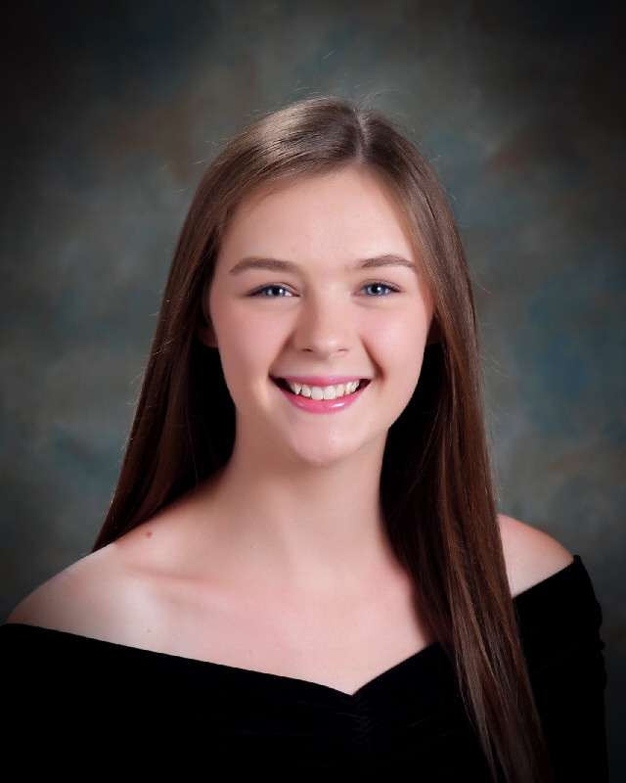
Abigail Hodgens
Scholarships

Slide 31
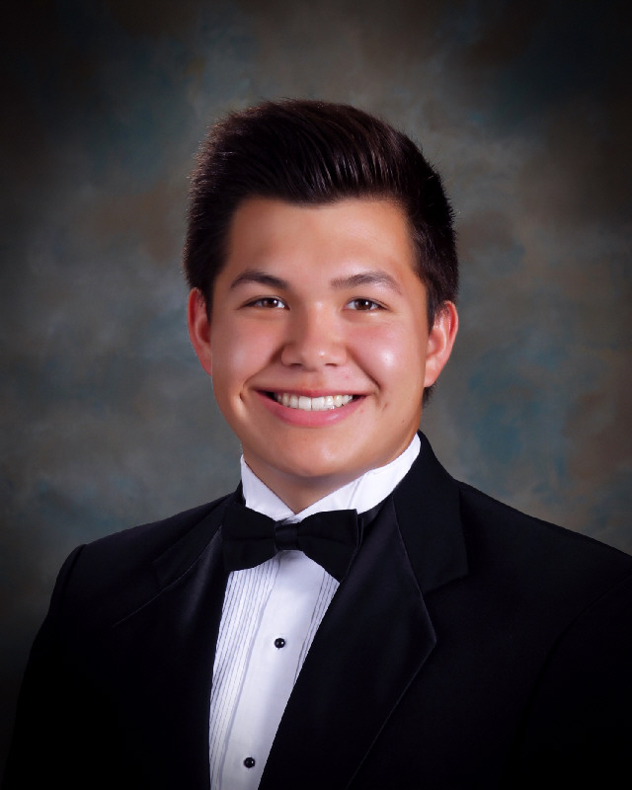
Chase Hunter
Scholarships

Slide 32
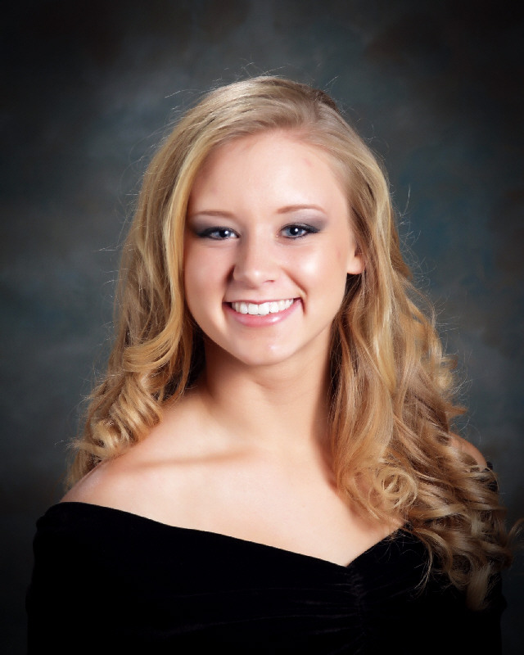
Alexis Joiner
Scholarships

Slide 33
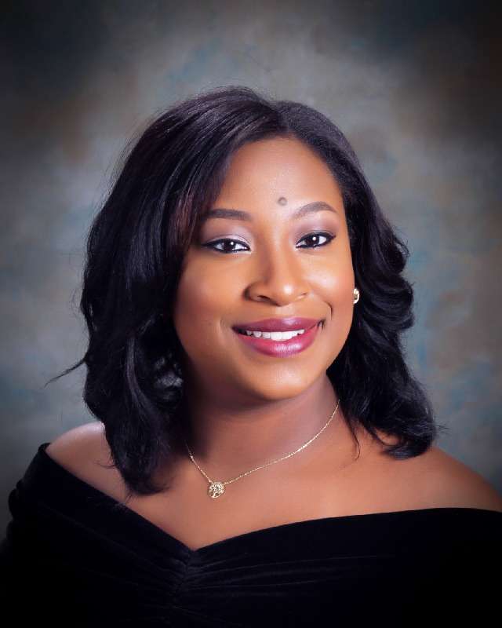
Akeera King
Scholarships

Slide 34
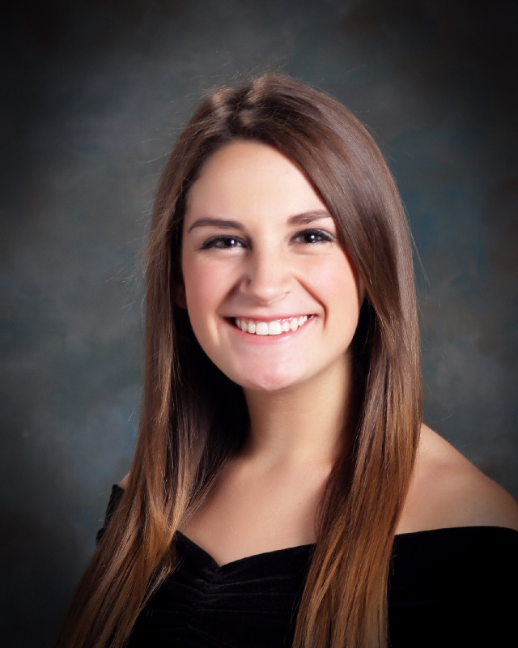
Hannah Lee
Scholarships

Slide 35
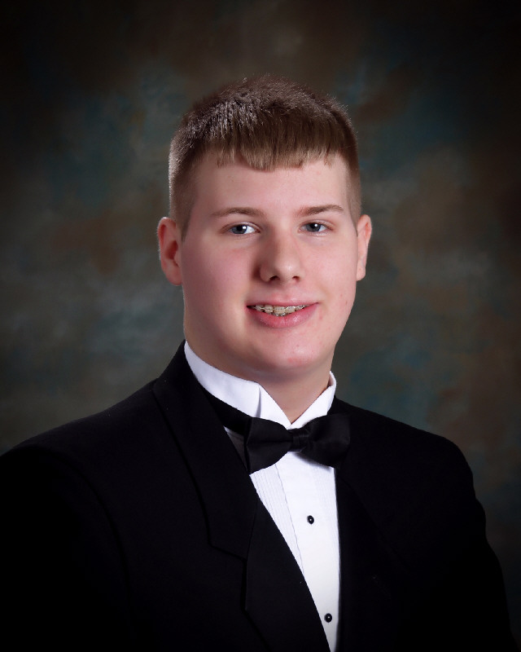
Zachary Leggett
Scholarships

Slide 36
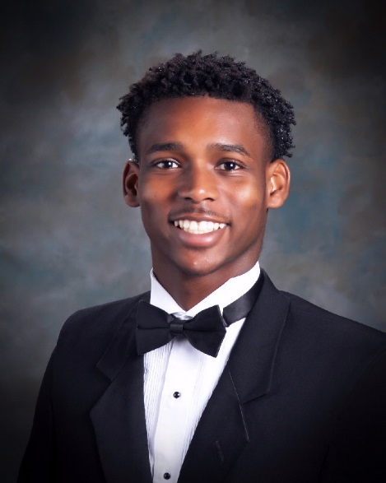
Jamichael Lipscomb
Scholarships

Slide 37
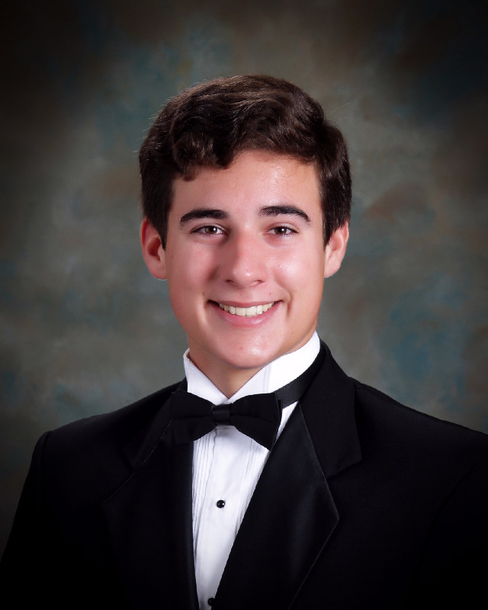
Turner Luker
Scholarships

Slide 38
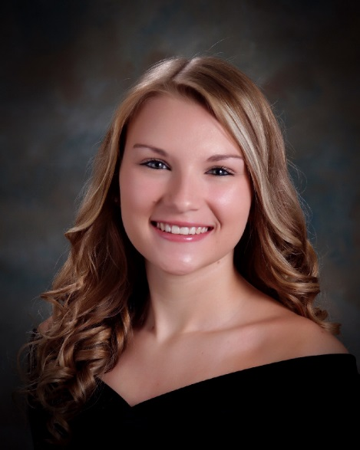
Kisha Lybrand
Scholarships

Slide 39
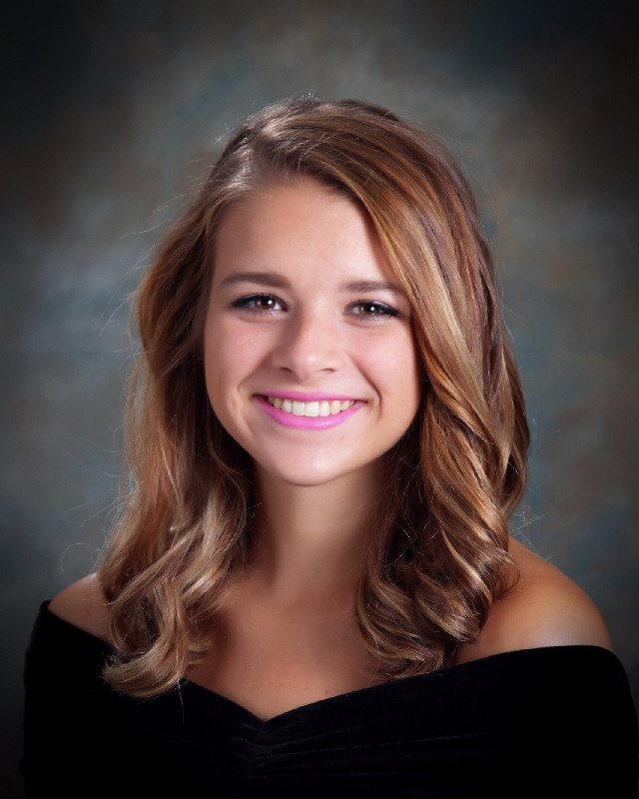
Abby Martin
Scholarships

Slide 40
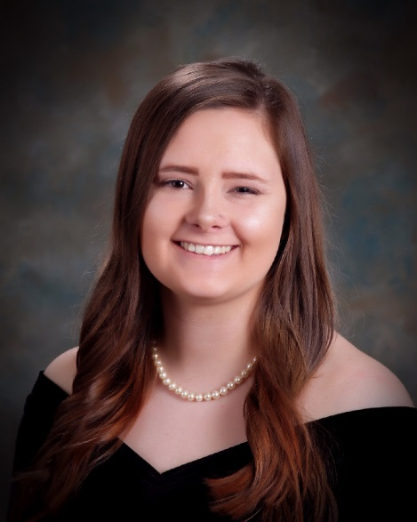
Madison Masters
Scholarships

Slide 41
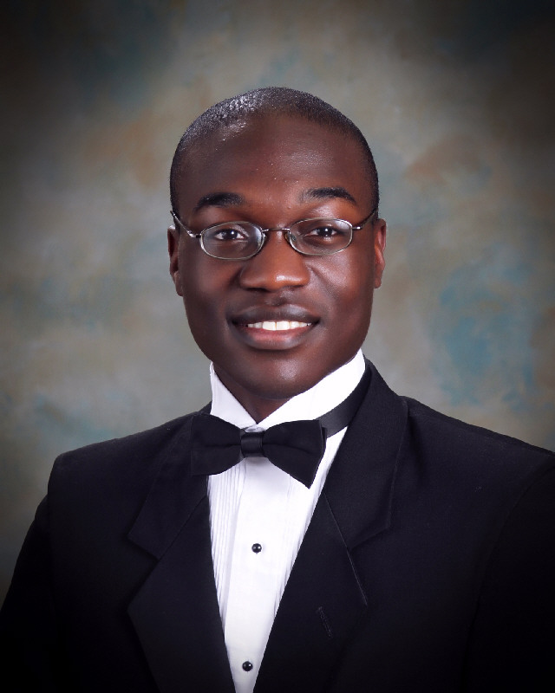
DeJon Matthews
Scholarships

Slide 42
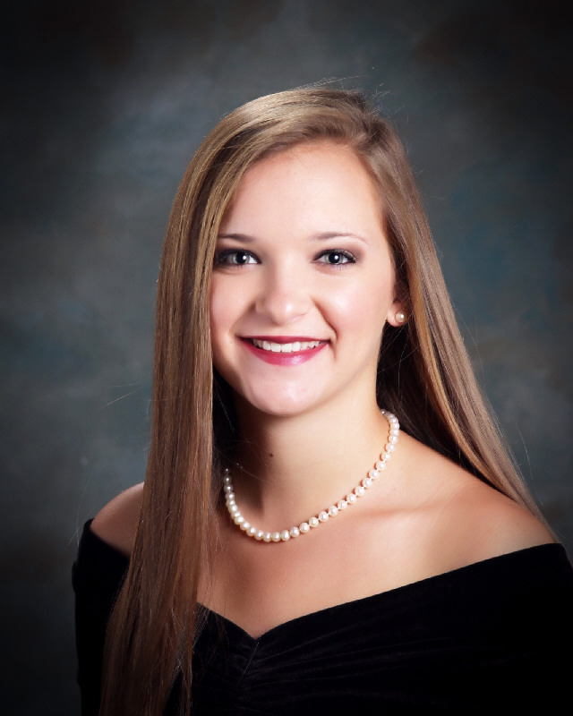
Ellie Mitcham
Scholarships

Slide 43
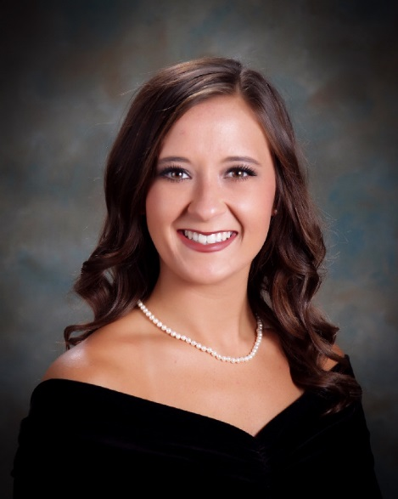
Layne Monistere
Scholarships

Slide 44
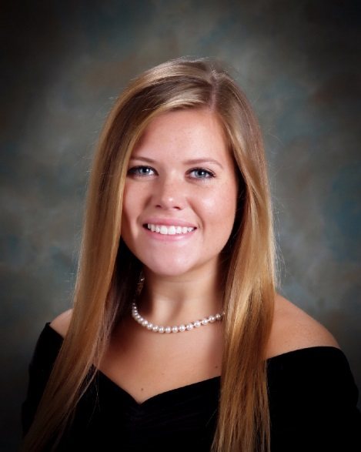
Brooklyn Morgan
Scholarships

Slide 45
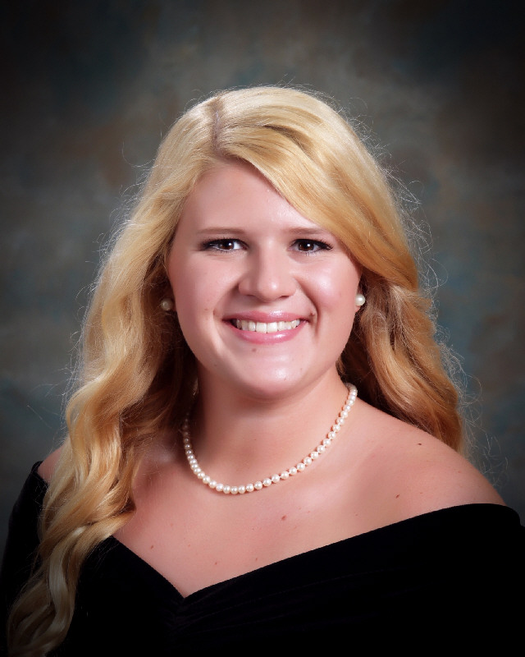
Emily Patterson
Scholarships

Slide 46
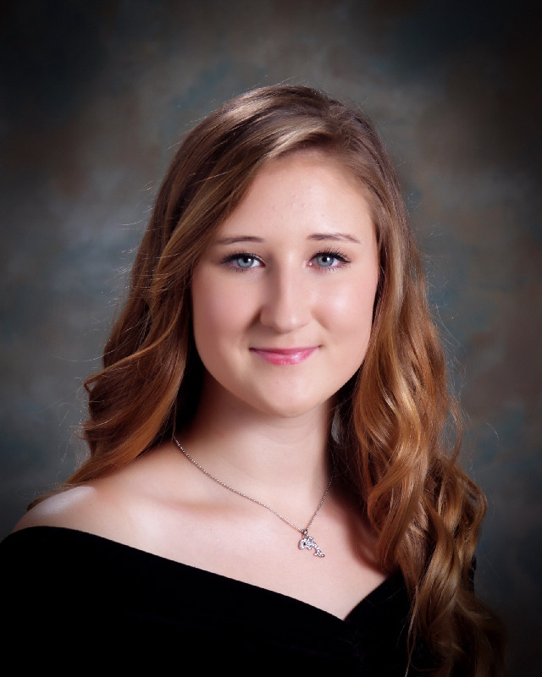
Alaina Payne
Scholarships

Slide 47
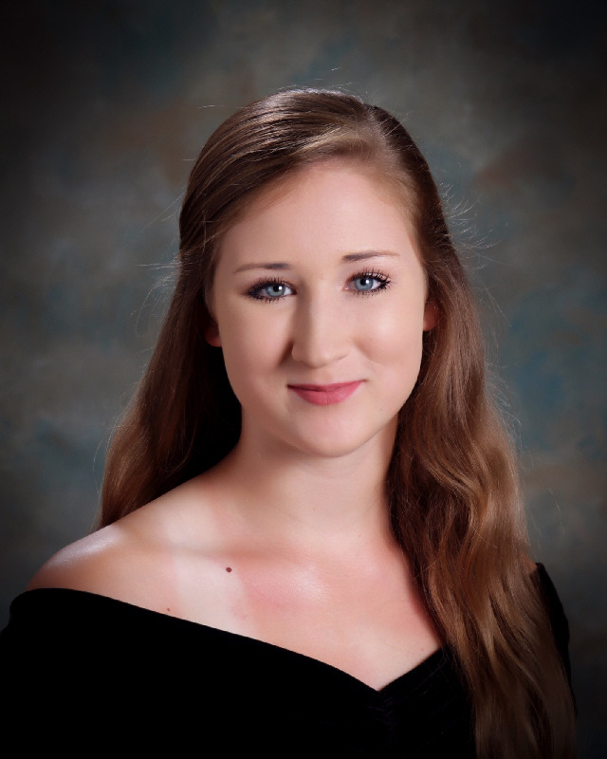
Alisin Payne
Scholarships

Slide 48
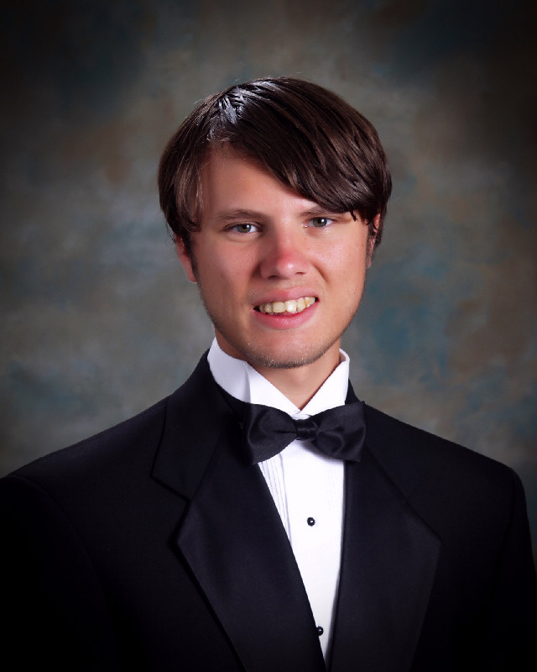
Noah Peavey
Scholarships

Slide 49
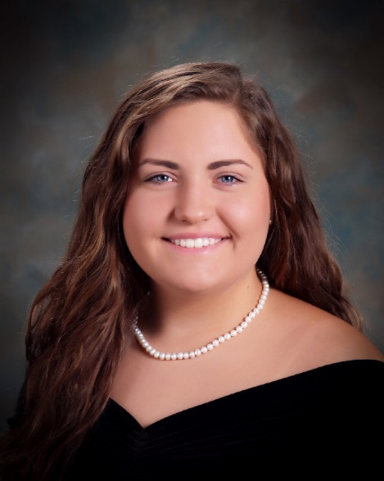
Sophie Poteracki
Scholarships

Slide 50
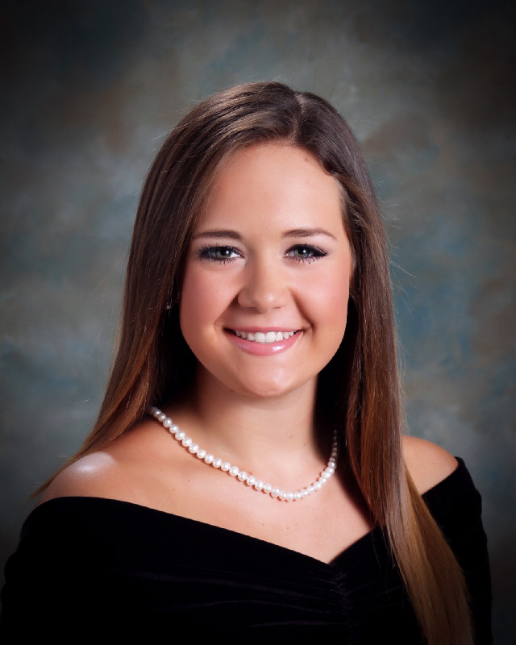
Emma Rich
Scholarships

Slide 51
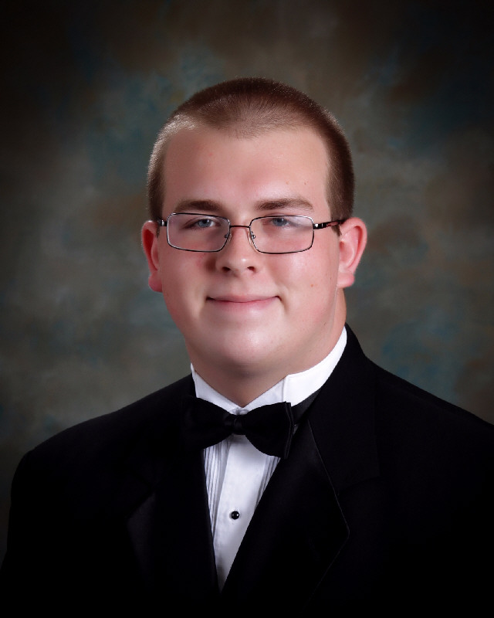
Joshua Richey
Scholarships

Slide 52
Meagan Roberts
Scholarships

Slide 53
Colten Robertson
Scholarships

Slide 54
Bailey Streety
Scholarships

Slide 55
Hannah Sweatt
Scholarships

Slide 56
Anna Claire Thomas
Scholarships

Slide 57
Madison Thomas
Scholarships

Slide 58
Lauren Tidwell
Scholarships

Slide 59
Kinsman Trammell
Scholarships

Slide 60
Abigail Traylor
Scholarships

Slide 61
Logan Tucker
Scholarships

Slide 62
Kylie Victory
Scholarships

Slide 63
Leah Walker
Scholarships

Slide 64
Austin Warren
Scholarships

Slide 65
Tamia Washington
Scholarships

Slide 66
Alex Whalen
Scholarships

Slide 67
Kelcy Williams
Scholarships

Slide 68
Tameron Williams
Scholarships

Slide 69
Jones Willingham
Scholarships

Slide 70
Jameson Willis
Scholarships

Slide 71
Annamarie Wilson
Scholarships

Slide 72
Madison Woods
Scholarships

